Slide 1
Machine Learning Project – Employee Promotion Prediction
Presented to Dr. Ghalia Nassreddine
Ahmad Hammoudeh-20210482
Ahmad Achaji-20210313
14/04/2025
Rafik Hariri University

Slide 2
Table of contents
1.
4.
2.
5.
3.
Dataset Overview and introduction
Models Used + insights
Data Preprocessing
Conclusion & Insights
Feature Selection
DD/MM/YYYY
Feature Name/Product
Your Company Name

Slide 3
1
Introduction and Dataset Overview
DD/MM/YYYY
Feature Name/Product
Your Company Name

Slide 4

Introduction
Predicting employee promotions is a critical task for organizations to ensure that career advancements are based on performance, potential, and fairness.
A well-designed predictive model helps eliminate bias, increase transparency, and supports data-driven decision-making, making the process both fair and precise.
DD/MM/YYYY
Feature Name/Product
Your Company Name

Slide 5
Dataset Overview
- Source: Department of Management Information System in Istanbul
- The Data set Consists of 12 Features 55000+ entries.
Target: Promotion status
Employee id | no of trainings
region | age
Department | Previous year rating
Education | awards_ won
Gender | length of service
Recruitment channel | avg training score
DD/MM/YYYY
Feature Name/Product
Your Company Name

Slide 6
2
Data Preprocessing
DD/MM/YYYY
Feature Name/Product
Your Company Name

Slide 7
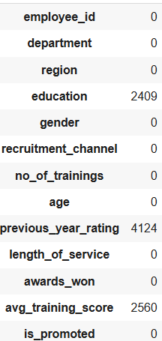
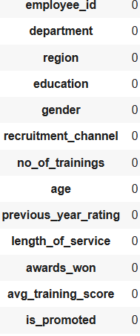
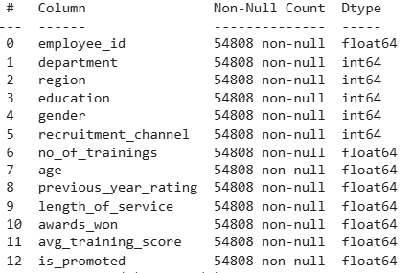
Data Preprocessing
1.
2.
3.
Handled null values
Removing Outliers, scaling and encoding
Converted object types:
Used mean for numerical columns.
And Used most recent/frequent for categorical ones
The data does not have any Oultliers and all entries are within range. So we didn’t need to use scaling.
Used Label Encoding to transform categorical features into numerical features
DD/MM/YYYY
Feature Name/Product
Your Company Name

Slide 8
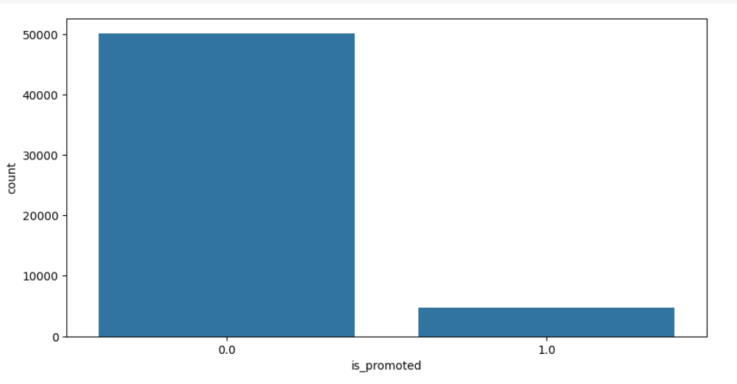
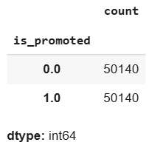
Data Preprocessing
Unabalnced data set
SMOTE
SMOTE helps balance the dataset by generating synthetic samples for the minority class.
The data set is unbalanced because the number of non promoted employees Is way higher and more frequent than promoted ones to solve this issue we used smote
How it works
1- For each sample, find its k-nearest neighbors
2- Randomly pick one neighbor.
3- Add a data point along the line in between.
DD/MM/YYYY
Feature Name/Product
Your Company Name

Slide 9
3
Feature selection
DD/MM/YYYY
Feature Name/Product
Your Company Name

Slide 10
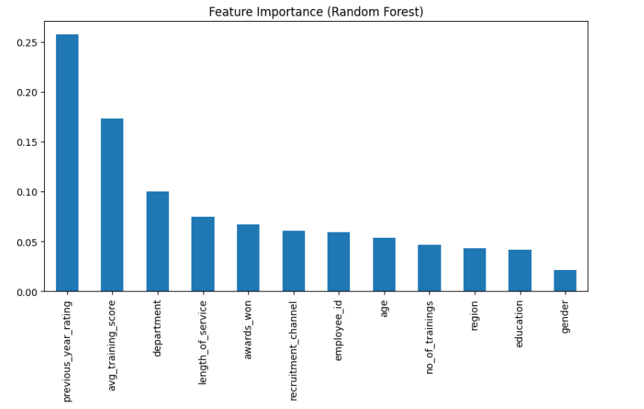
Data Preprocessing
Random Forest: Measured feature importance
RF provides a measure of feature importance based on how useful each feature is in improving the accuracy of the model.
How it works
RF is an ensemble of decision trees. Each tree splits on features to reduce impurity.
Features that contribute more to reducing impurity get higher importance scores.
DD/MM/YYYY
Feature Name/Product
Your Company Name

Slide 11
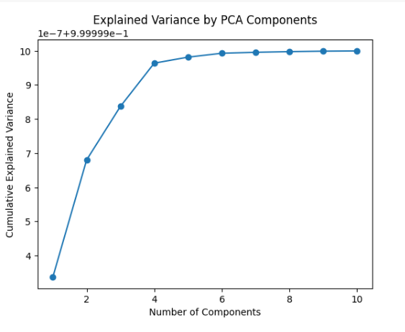
Data Preprocessing
PCA
Principal Component Analysis (PCA) reduces the number of features while keeping the most important information from the data.
How it works
Each PCA component is a new feature created by combining original features.
Components are ranked by how much variance (information) they explain from the original data.
DD/MM/YYYY
Feature Name/Product
Your Company Name

Slide 12
4
Models Used
DD/MM/YYYY
Feature Name/Product
Your Company Name

Slide 13
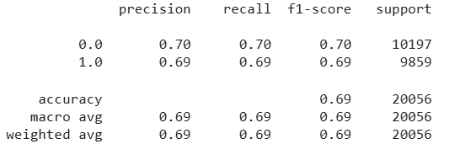
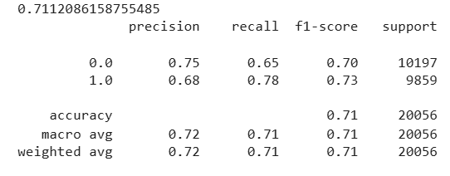
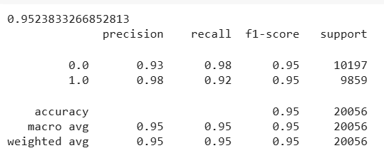
Models Used
Logistic Regression
A linear model that predicts the probability of a binary outcome using a logistic function.
SVM
Finds the optimal boundary (hyperplane) that best separates the classes with maximum margin..
Decision Tree
A tree-based model that makes decisions by splitting data into branches based on feature values.
DD/MM/YYYY
Feature Name/Product
Your Company Name

Slide 14
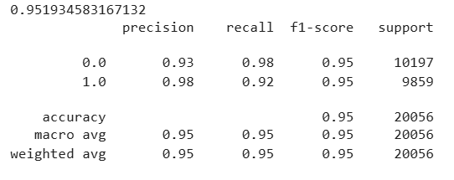
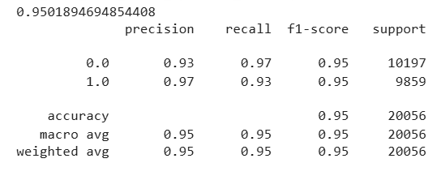
Models Used
Random Forest
An ensemble of decision trees that improves accuracy and reduces overfitting through majority voting.
Stacking model
Combines multiple base models to improve prediction by training a meta-model on their outputs.
DD/MM/YYYY
Feature Name/Product
Your Company Name

Slide 15
Model performance overview
What can we deduce ?
Model | Running time | Accuracy | Recall
Logistic Regression | 1min | 69% | 69%
SVM | 4.7min | 71% | 78%
Decision Tree | 37 sec | 95% | 92%
Random Forest | 45 sec | 95% | 92%
Stacking model | 27 min | 95% | 93%
Both LR and SVM have poor accuracy and recall and are not reliable to use.
The decision tree, random forest, and stacking model both have similar accuracy. However, both random forest and DT models are much more efficient to run compared to the stacking model which has only a 1% increase in recall.
DD/MM/YYYY
Feature Name/Product
Your Company Name

Slide 16
5
Conclusion
DD/MM/YYYY
Feature Name/Product
Your Company Name

Slide 17
Conclusion
Through effective data preprocessing, feature selection, and model stacking, we successfully built a machine learning system that predicts employee promotions with improved accuracy. This approach supports fair and data-driven HR decisions, helping organizations recognize and reward the right talent.
DD/MM/YYYY
Feature Name/Product
Your Company Name

Slide 18
Thanks!
Do you have any questions?
ahmadhammoudeh18@gmail.com
ahmadachaji88@gmail.com
DD/MM/YYYY
Feature Name/Product
Your Company Name

